Slide 1
HOSTEL MANAGEMENT SYSTEM PRESENTED BY : 221FA20017 S.SRIKAVYA

Slide 2
INTRODUCTION
The Hostel Management System is a tool that helps manage all aspects of running a hostel easily and efficiently. It allows admins to keep track of student records, handle fees payments, assign rooms, and create student reports. The system also helps with daily tasks like recording attendance, managing visitors, reporting maintenance issues, sending important notifications, and keeping a record of any disciplinary actions. Overall, it makes managing a hostel simpler, safer, and more organized for everyone involved.

Slide 3

MODULES included: student’s module block allotment module fEE payment module mess module students Attendance module Appointment of hostel manager module profile module

Slide 4

Main Objectives of this project
1.Student will no longer apply for their hostels manually
2.This also will reduce the manual work of the persons in admin penal.
3.To save time
4.To increase efficiency of students
5.For fast access of data
6.For secure and smooth running of the program
7.For error free, effective and easy for database related works.

Slide 5
Methodology use:
Hardware Requirements :-
Processor:2.5GHz
RAM: min 4GB
Software Requirements:-
Xampp server, Windows/mac operating system
Language:- HTML,CSS,JAVASCRIPT,PHP,MYSQL

Slide 6
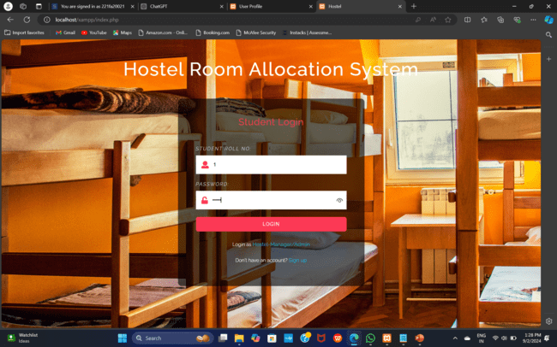

Slide 7
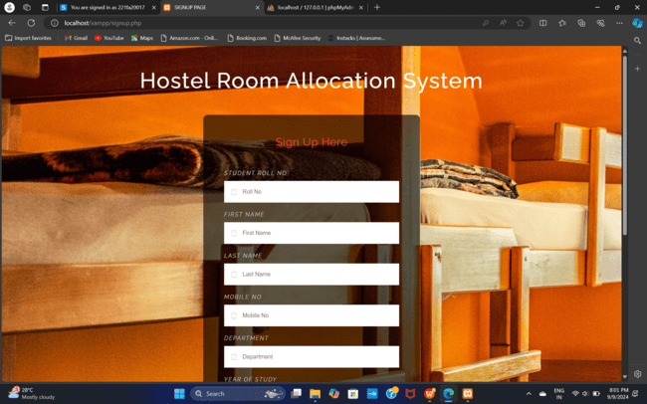

Slide 8
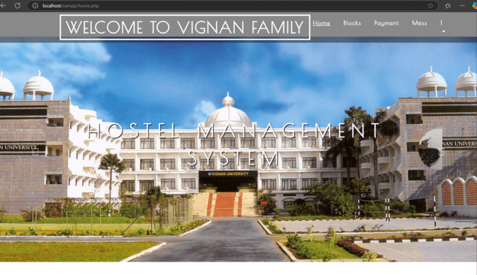

Slide 9
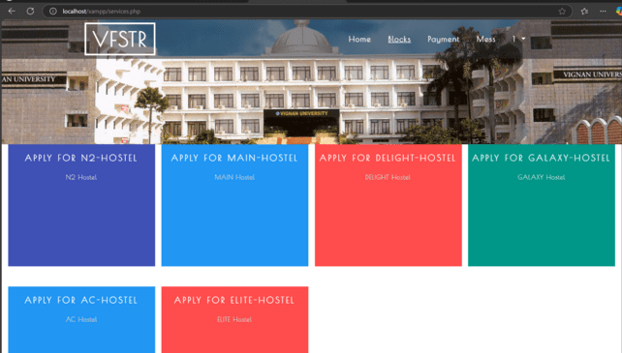

Slide 10
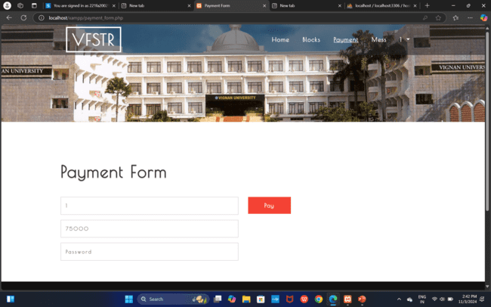

Slide 11


Slide 12
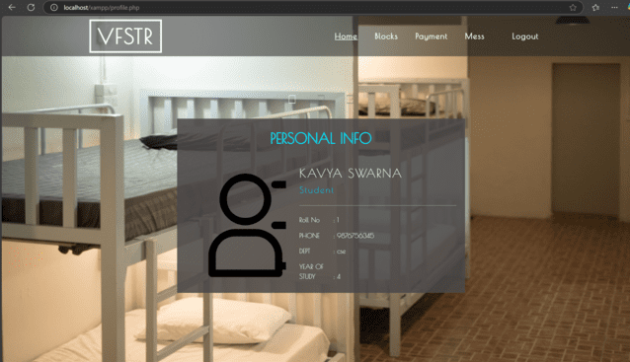

Slide 13
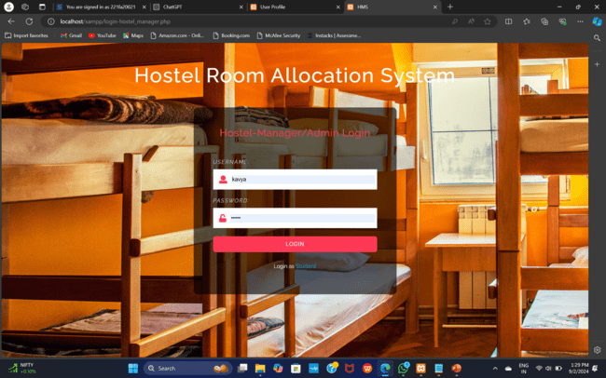

Slide 14


Slide 15
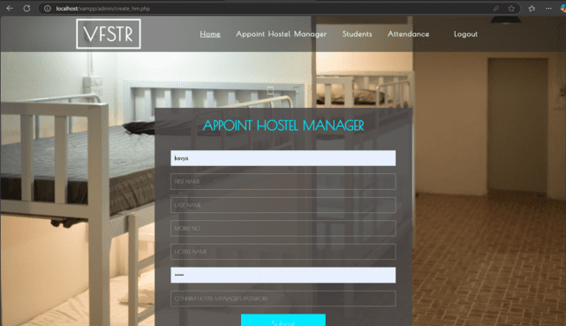

Slide 16
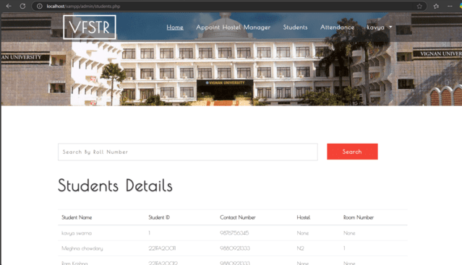

Slide 17
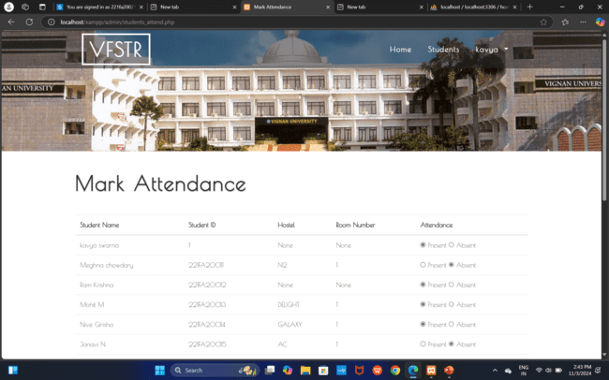

Slide 18


Slide 19


